Slide 1
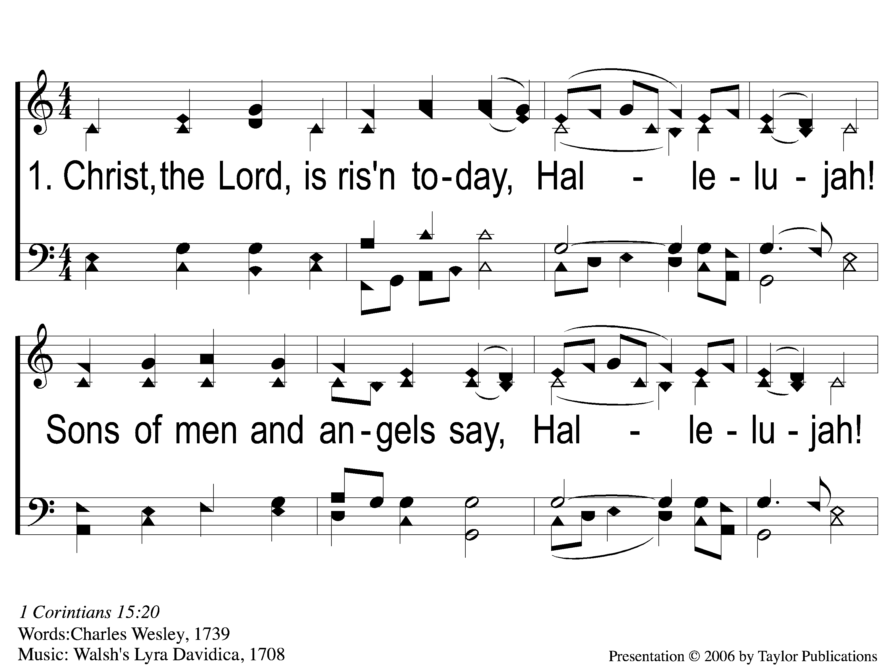
1-1 Christ the Lord is Risen Today
Christ the Lord is Risen Today
64

Slide 2
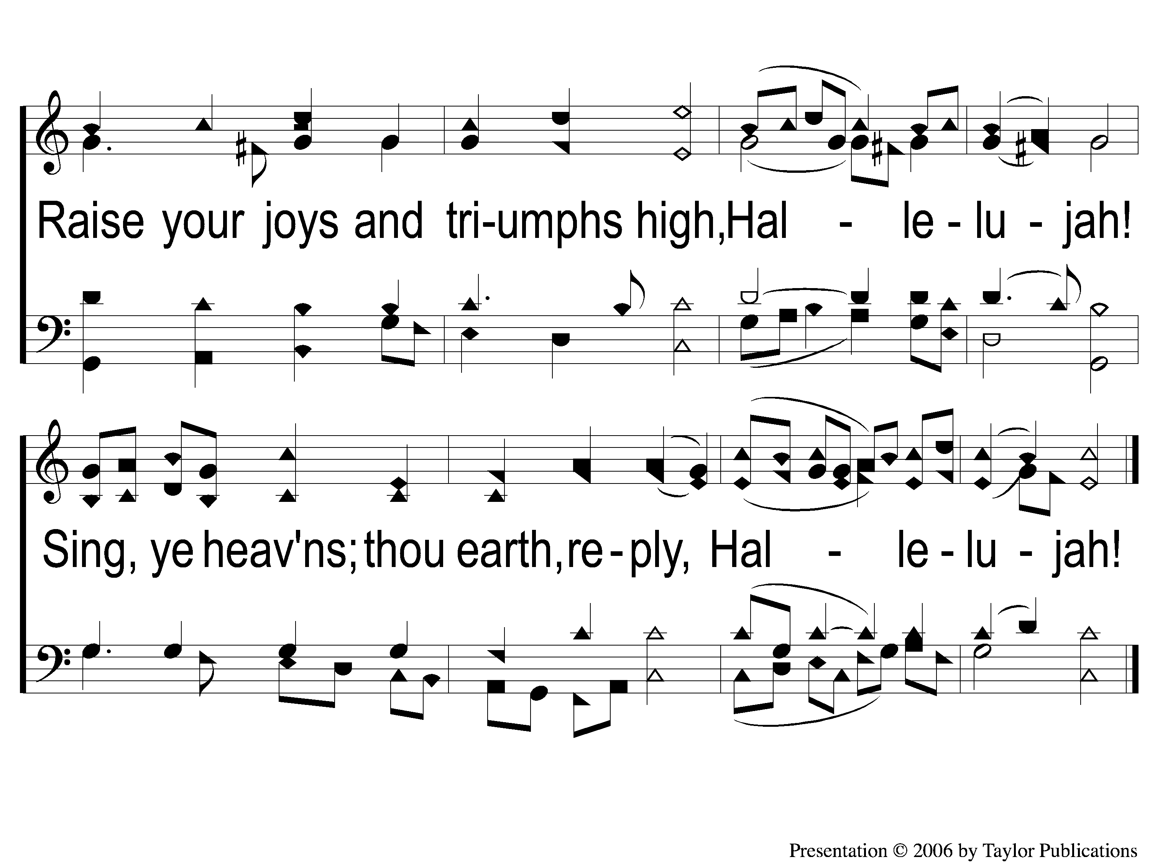
1-2 Christ the Lord is Risen Today
Christ the Lord is Risen Today
64

Slide 3
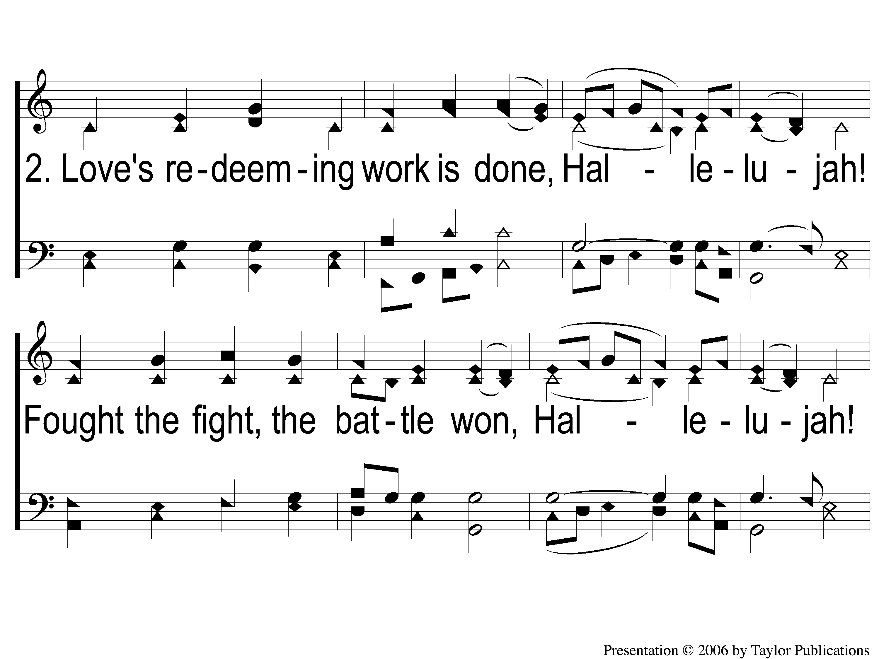
2-1 Christ the Lord is Risen Today
Christ the Lord is Risen Today
64

Slide 4
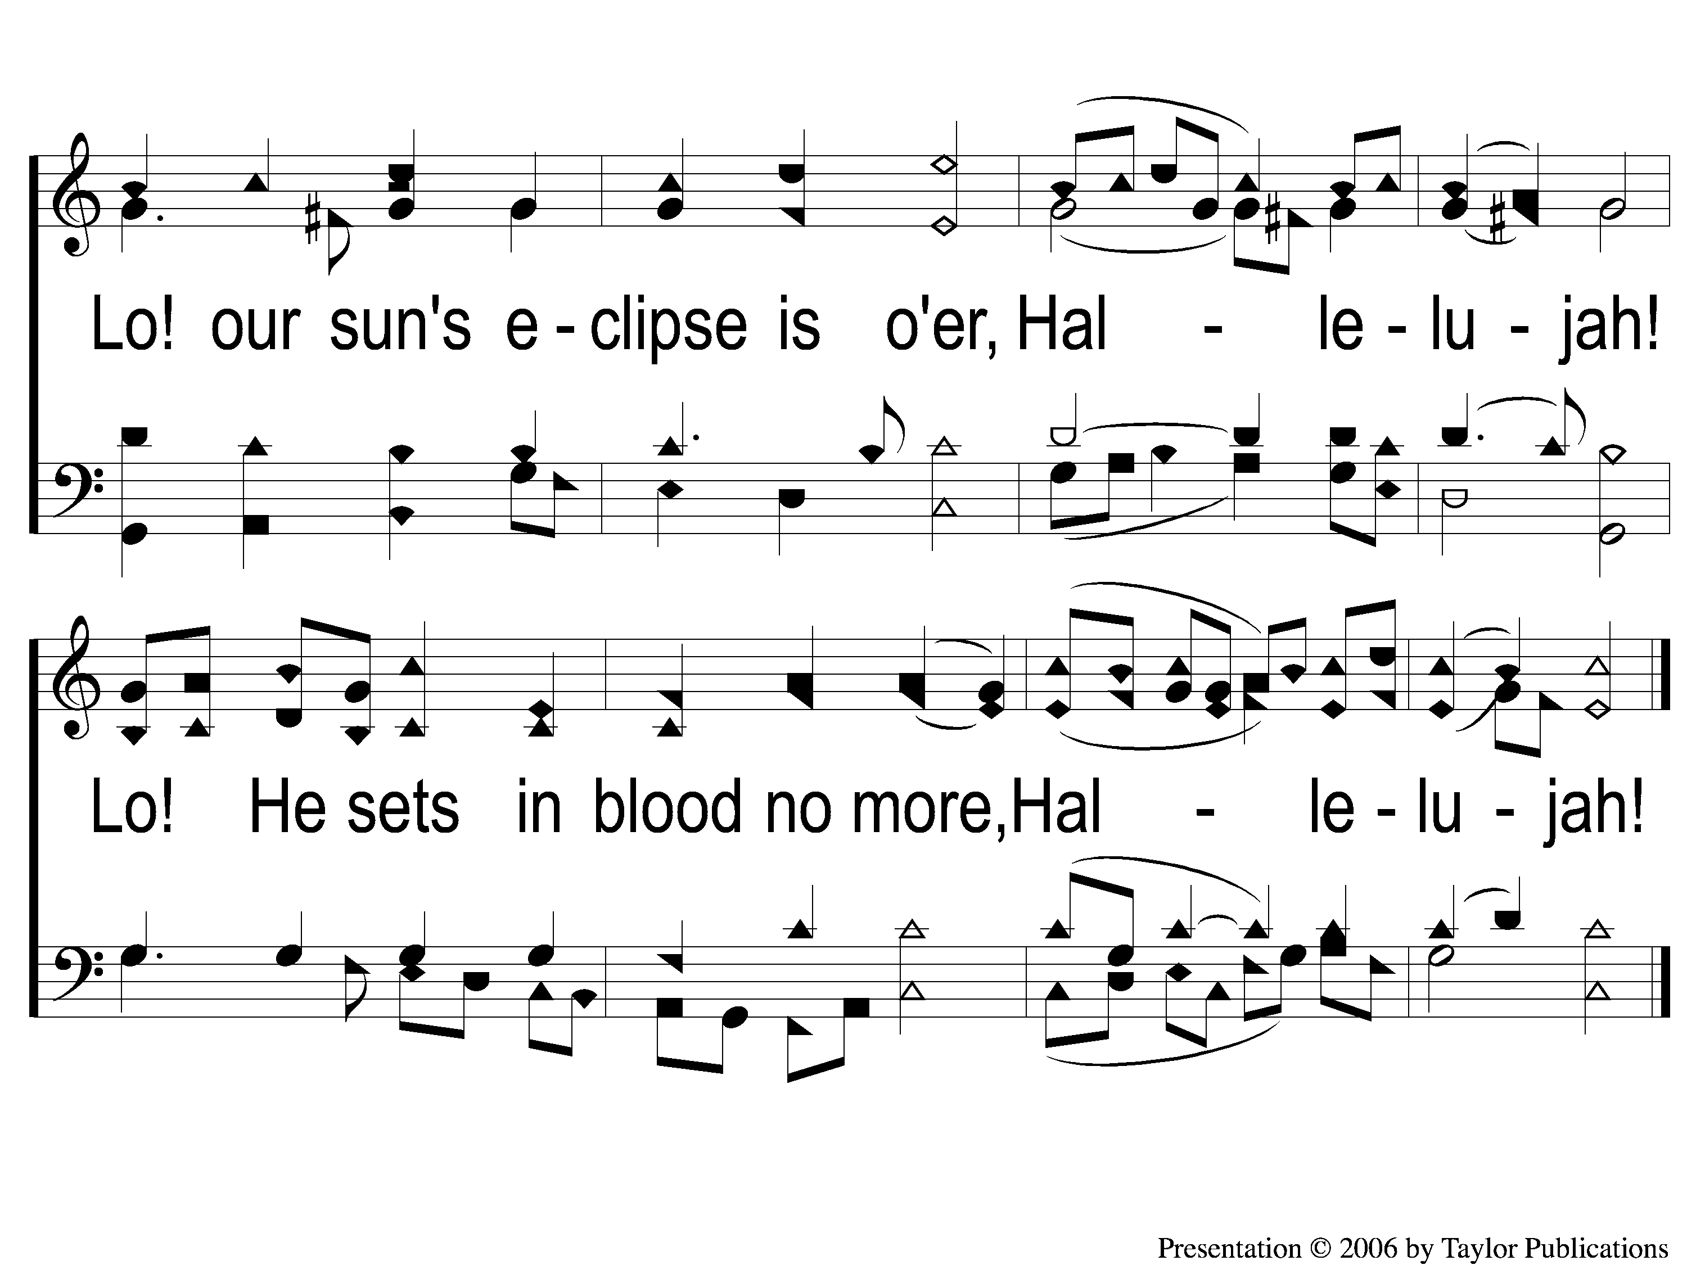
2-2 Christ the Lord is Risen Today
Christ the Lord is Risen Today
64

Slide 5
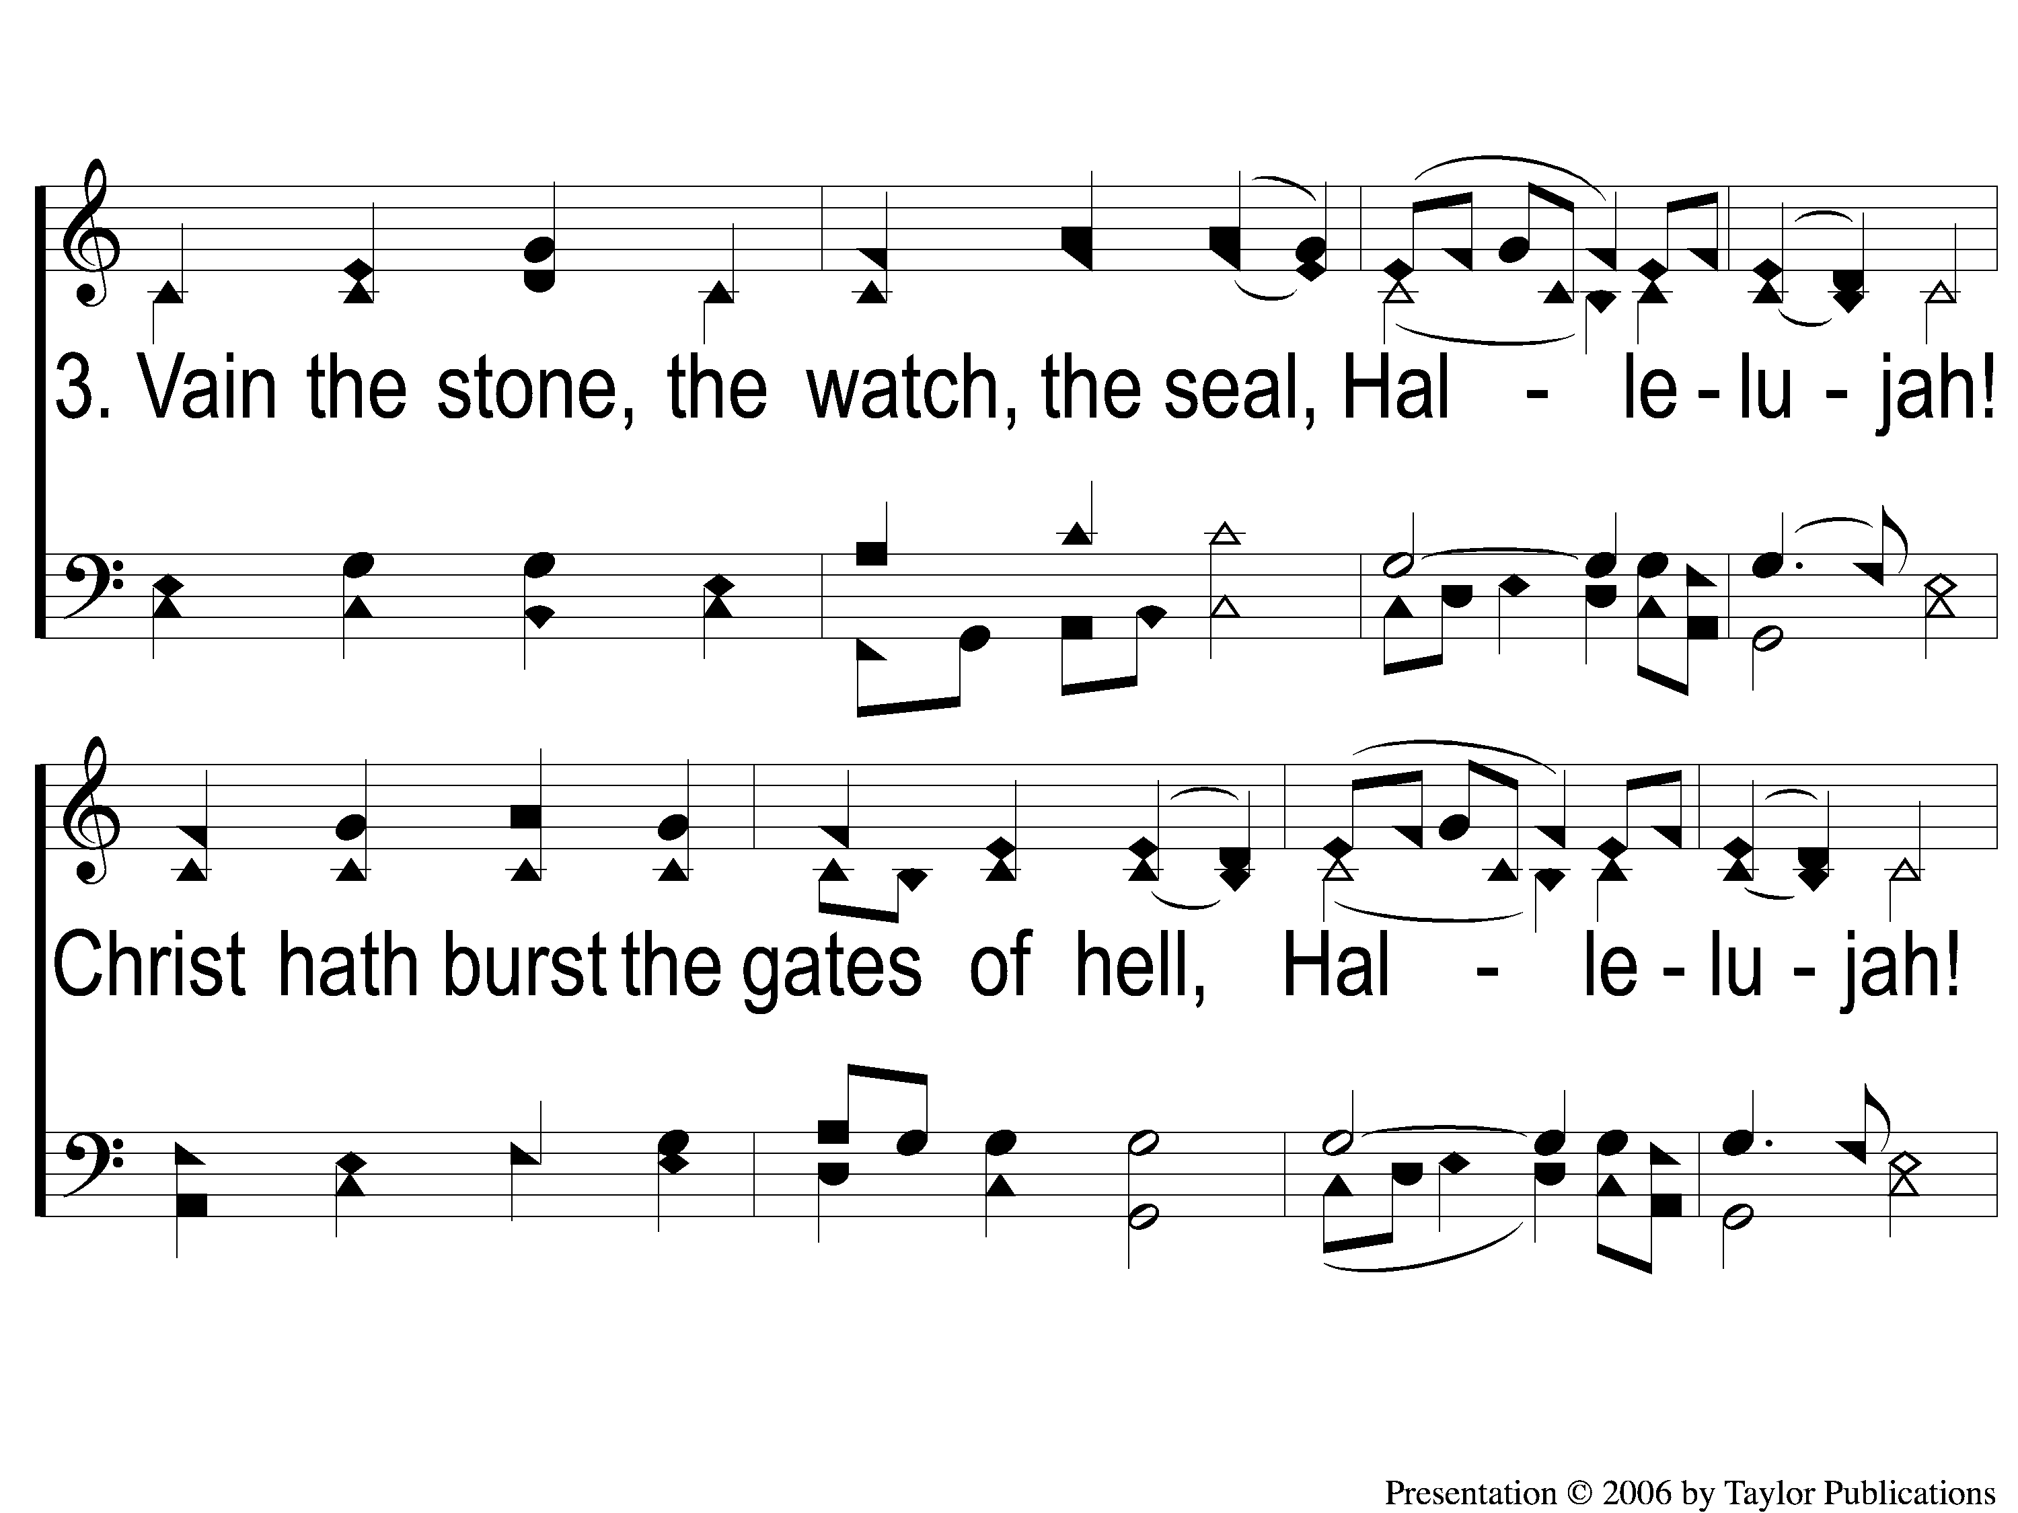
3-1 Christ the Lord is Risen Today
Christ the Lord is Risen Today
64

Slide 6
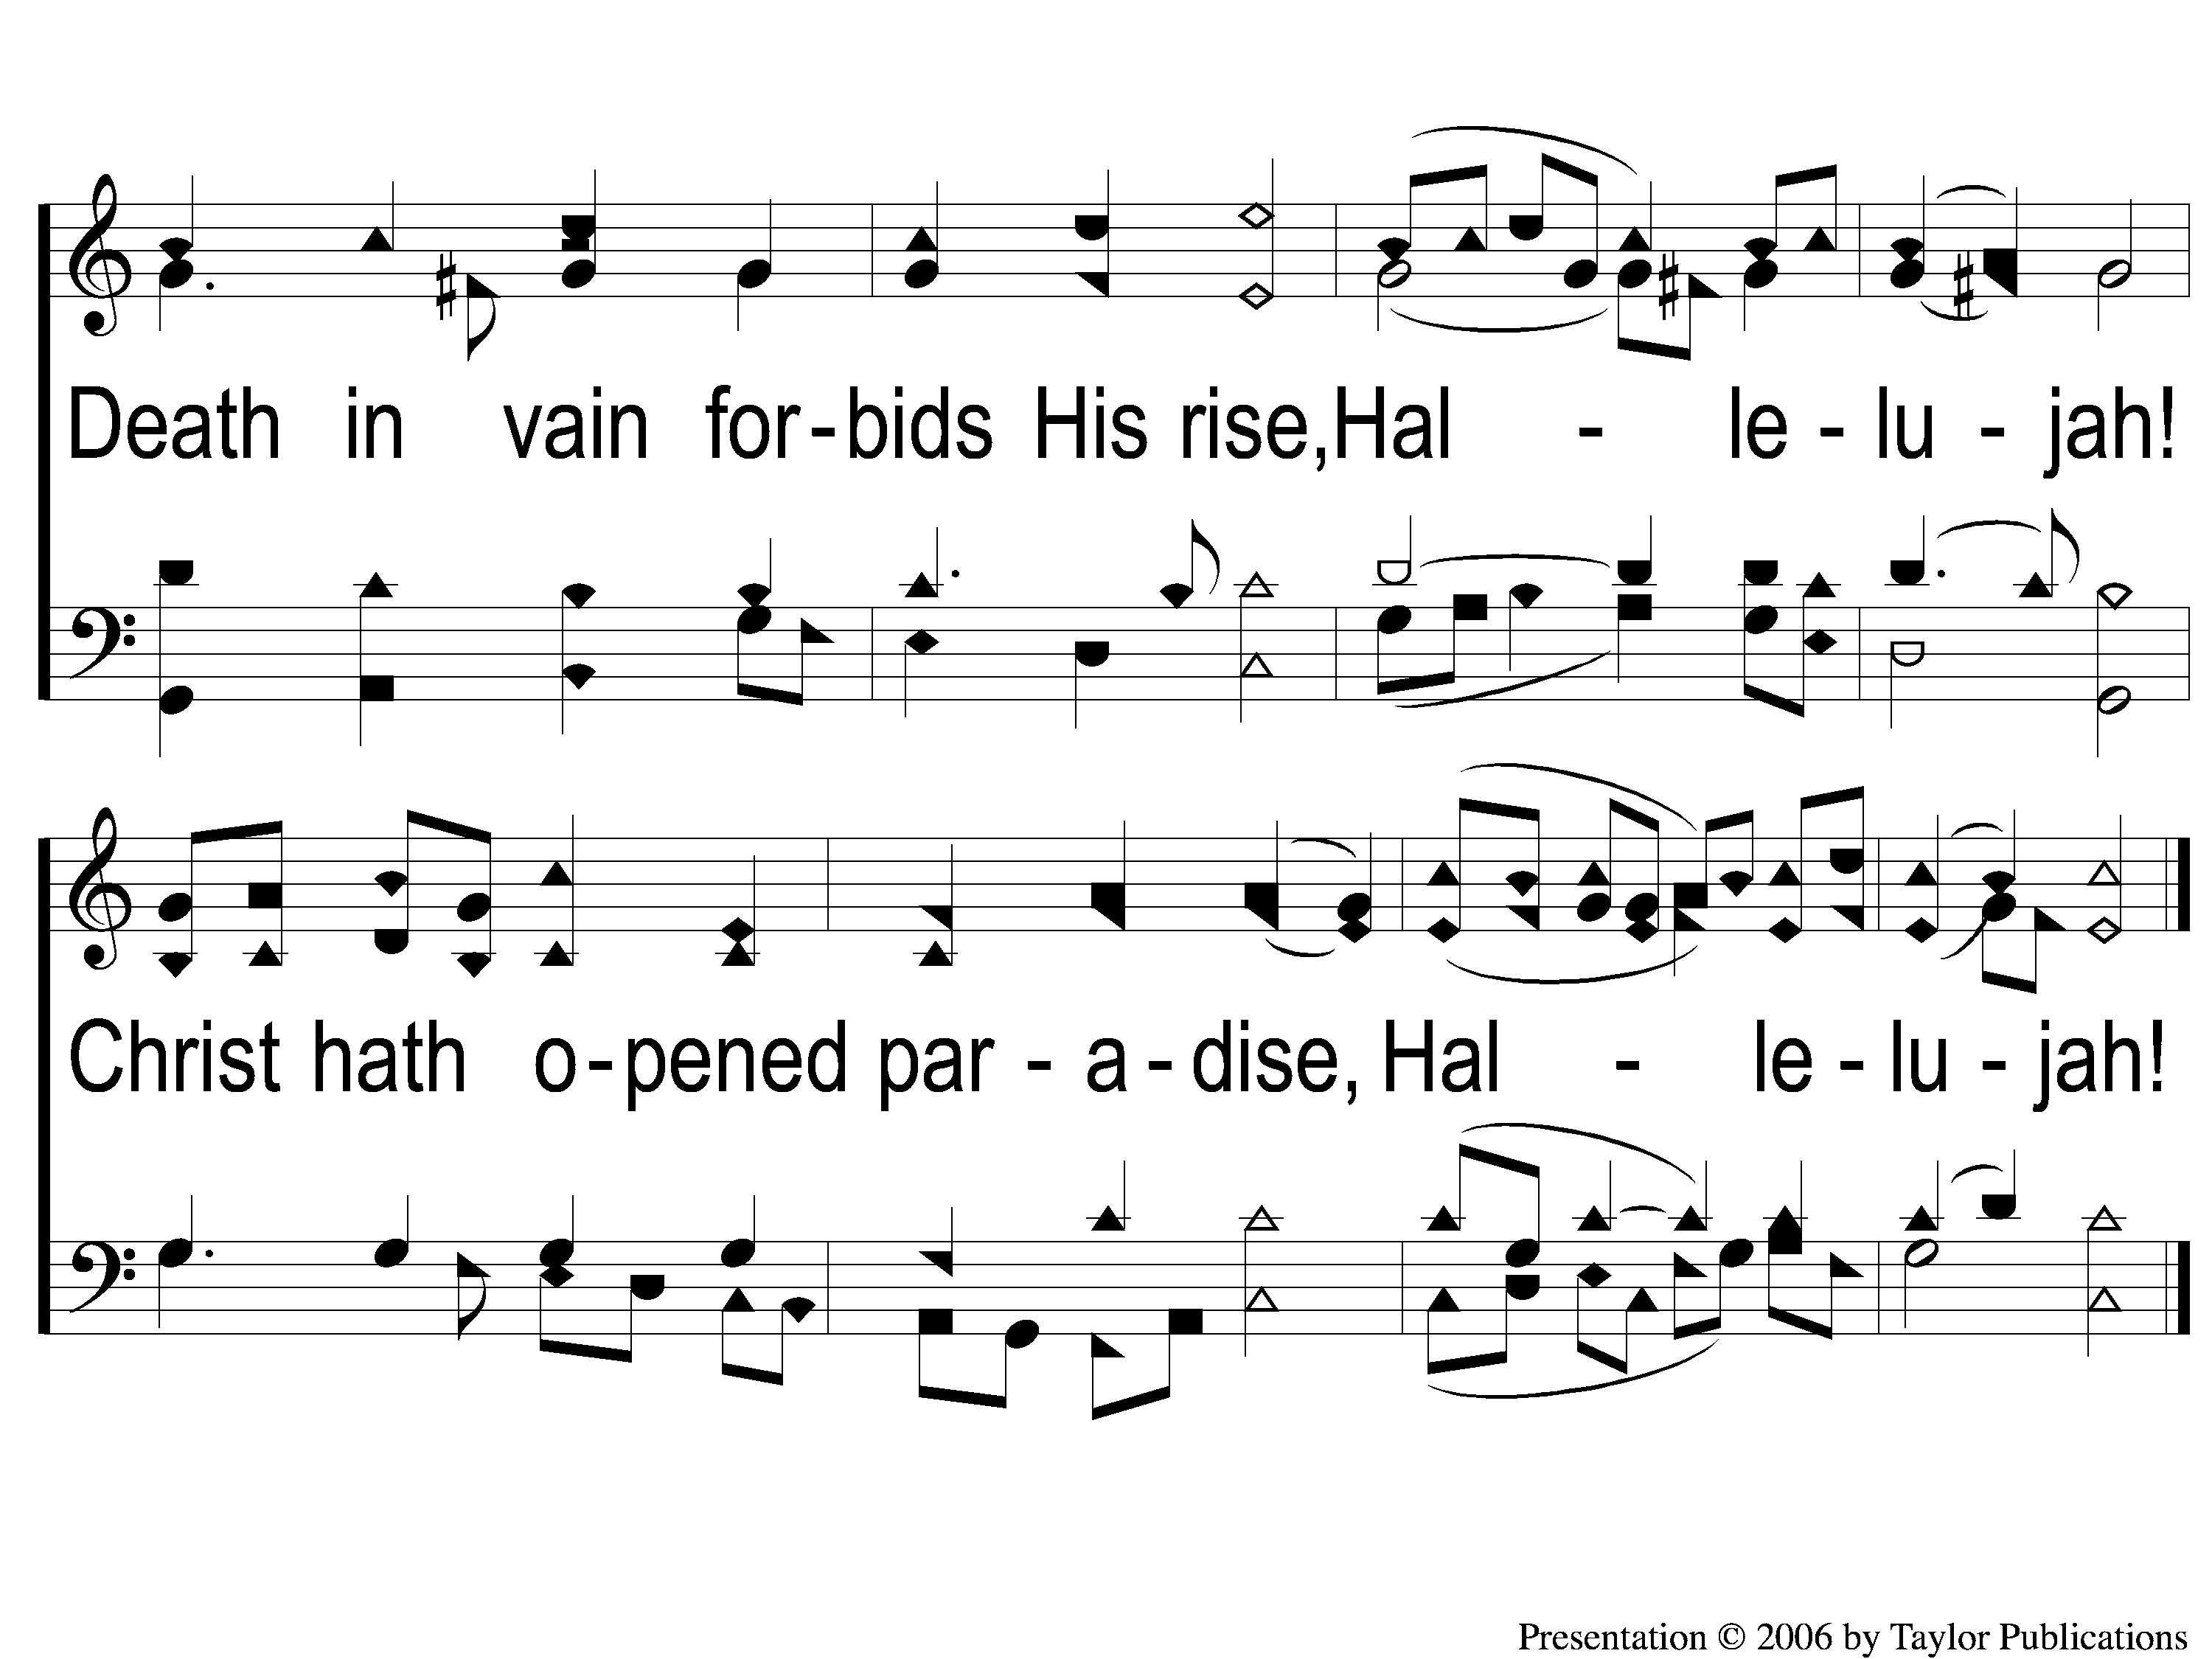
3-2 Christ the Lord is Risen Today
Christ the Lord is Risen Today
64

Slide 7
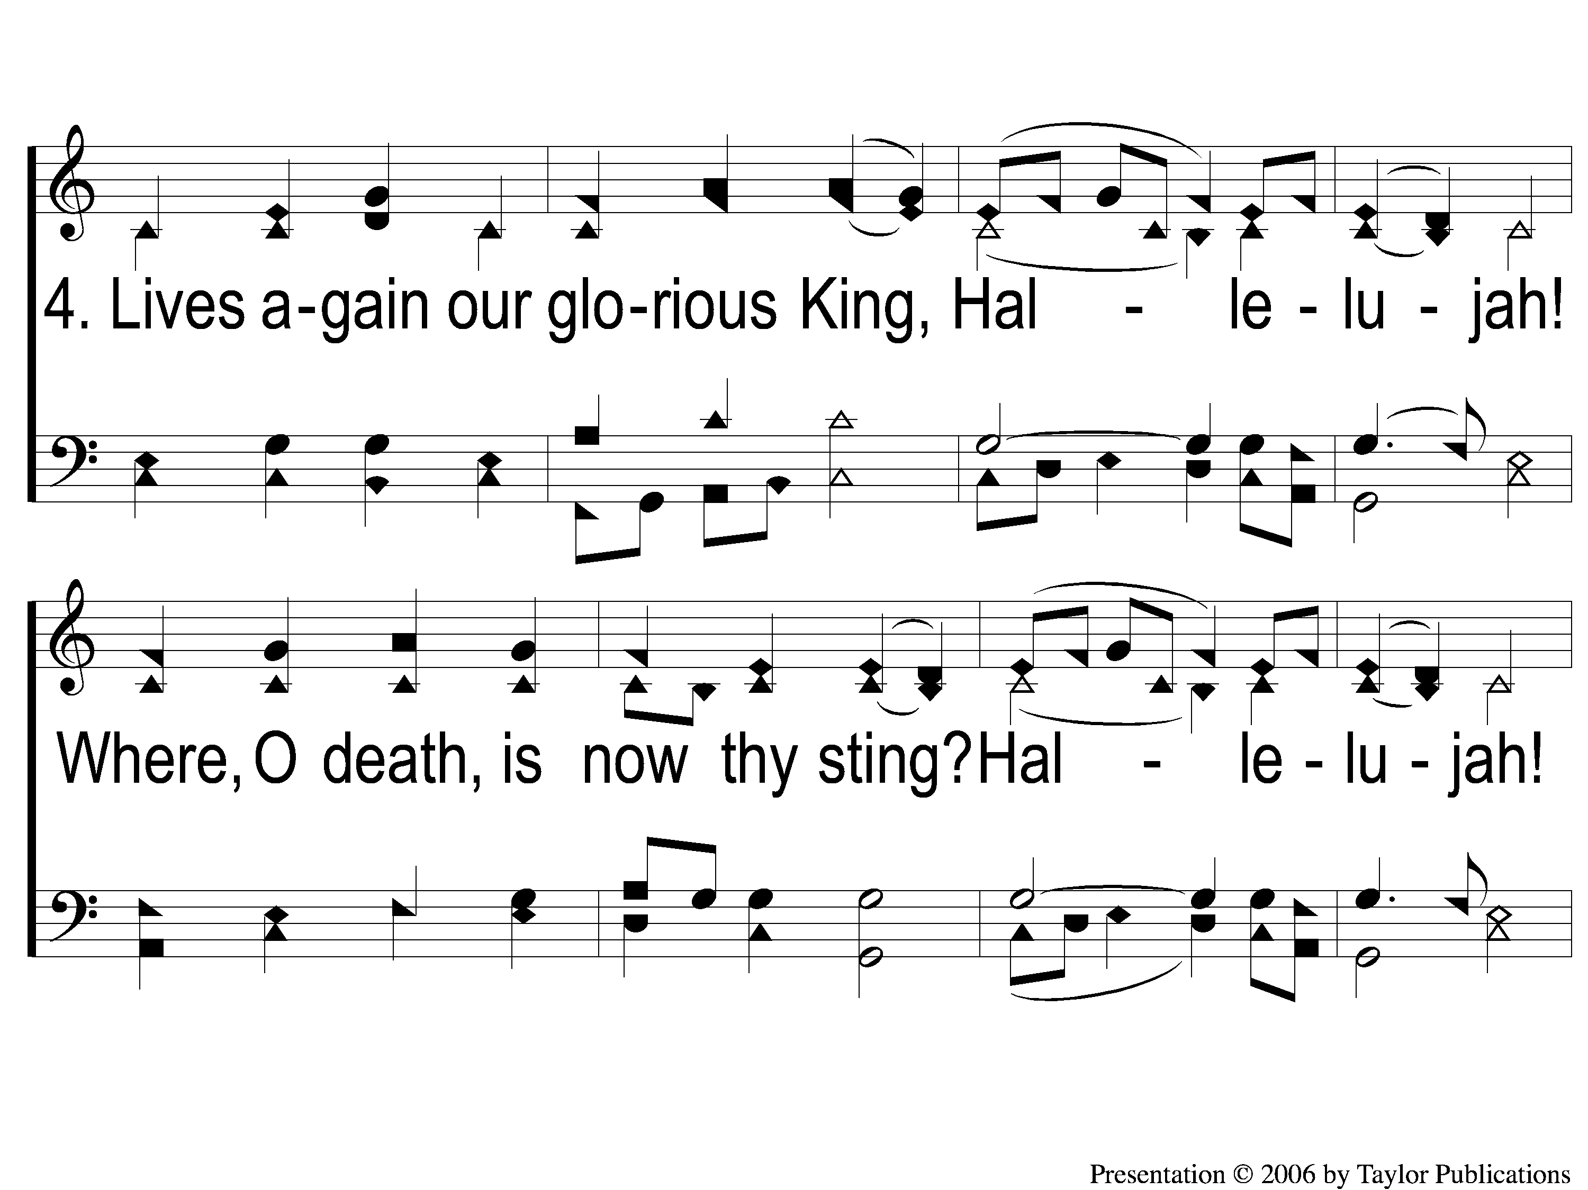
4-1 Christ the Lord is Risen Today
Christ the Lord is Risen Today
64

Slide 8
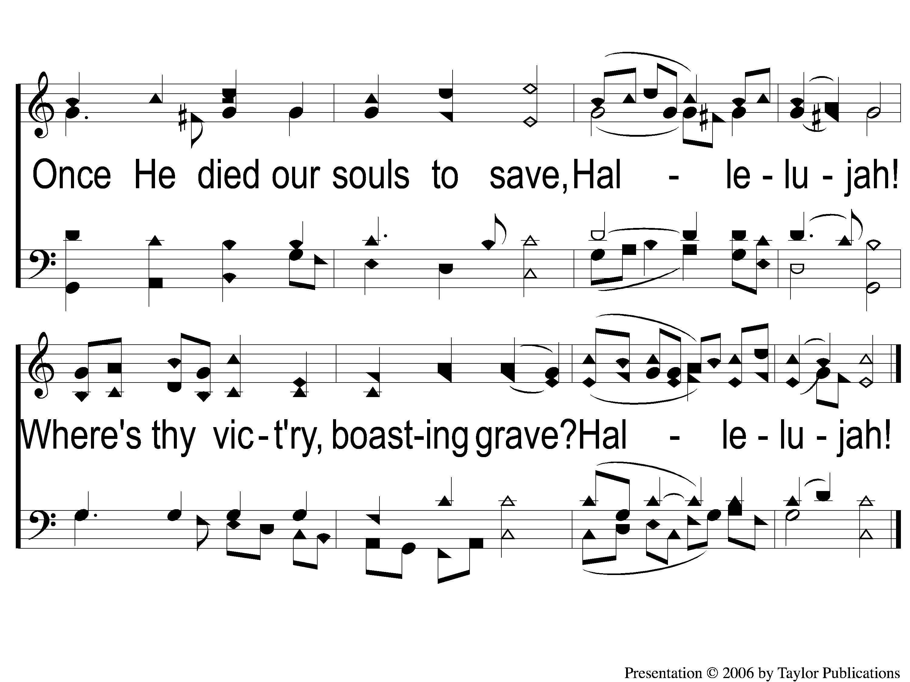
4-2 Christ the Lord is Risen Today
Christ the Lord is Risen Today
64

